Slide 1

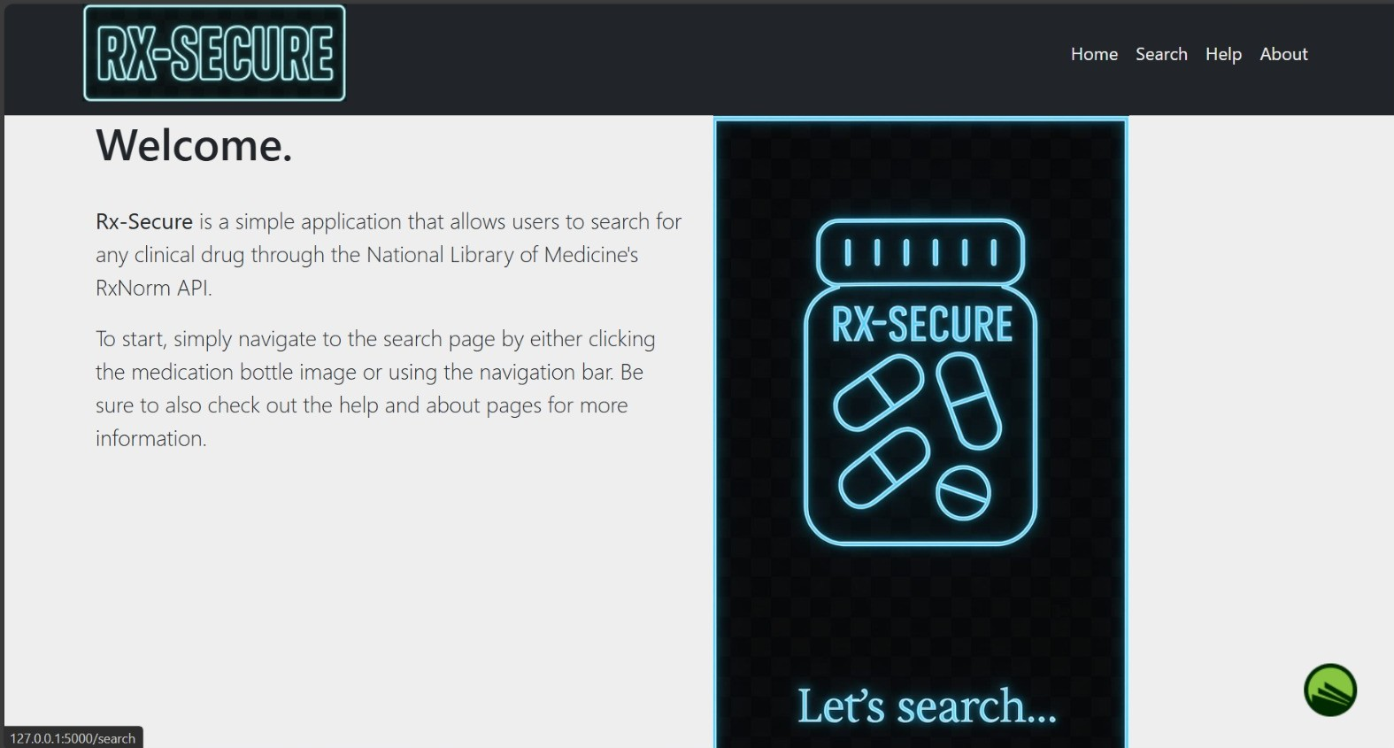
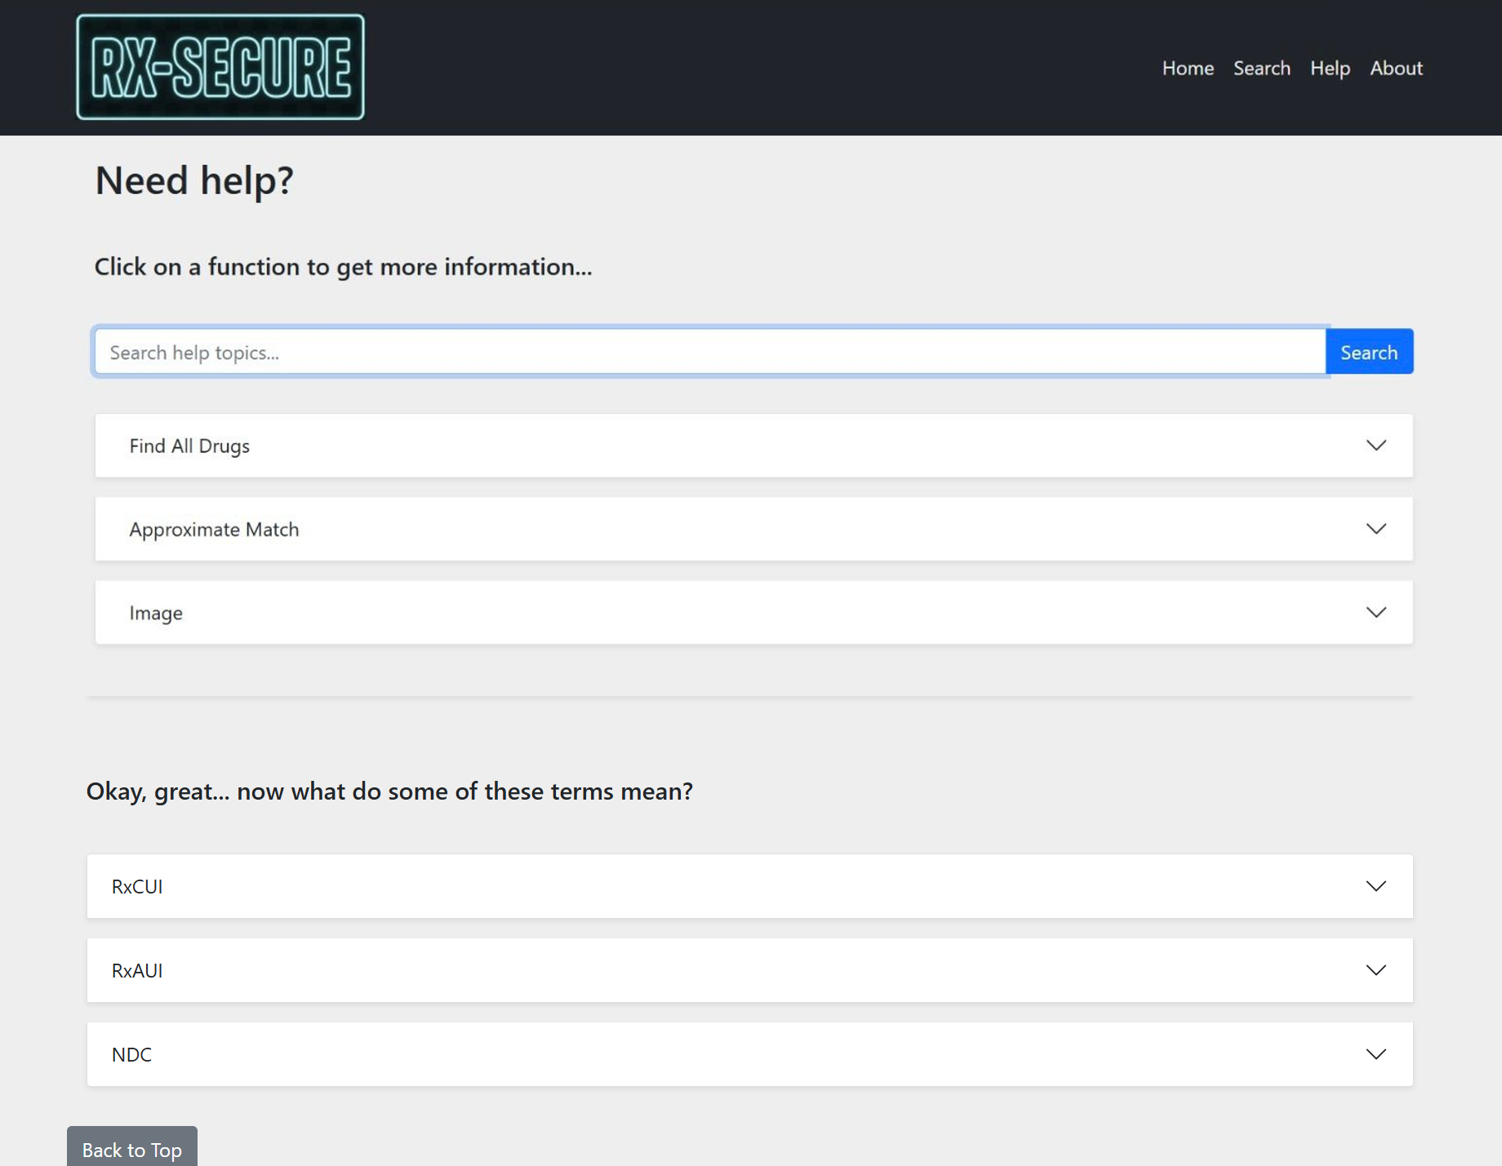
Rx-Secure - Medicine Ingredient and Allergy Checker
A simple app that helps users check drug ingredients and spot potential allergens using the Rx-Norm API.​ Get alerts, stay safe, and make smarter medication choices.​
Why It Matters:​ Many people take meds without knowing the risks. Rx-Secure prevents allergic reactions and promotes safer use.​
Who It's For:​ ✔️ People with allergies​ ✔️ Caregivers & parents​ ✔️ Healthcare providers​ ✔️ Chronic condition patients​ ✔️ Anyone taking medications​
GitHub URL: https://github.com/ksu-hmi/Rx-Secure
Source: https://github.com/chrismannina/med-magic
Coders:
Krutiben Bhalodia,
Pravinya Mandalapu,
Mevin Ansa

